Slide 1
Design of a Non-Invasive Transabdominal Fetal Pulse Oximeter
1

Slide 2
Project Description
1

Slide 3
Introduction
Non-Invasive Fetal pulse oximetry is a promising new technique currently under development for intrapartum monitoring, which gives information on oxygen saturation.
It permits direct assessment of the fetal oxygen status, which is likely to be a better indicator of fetal well-being.

Slide 4
Problem Statement
The use of conventional cardiotocographic (CTG) monitoring of fetal well-being before birth and during labor is associated with an increased caesarean section rate which could have been prevented through a normal delivery (Spontaneous vaginal delivery).
To reduce the number of caesarean sections performed for non-reassuring fetal status, adaptation of pulse oximetry for use in the unborn fetus could potentially contribute to improved evaluation. This could, therefore, lead to a reduction in caesarean sections without any change in neonatal outcome.

Slide 5
Team Introduction
2

Slide 6
Team introduction
M. Umair Arif R&D Facilitator
Syed Amer Kabir Project Consultant
Dr.Ali Shoaib Medical Consultant
Dr.Sumayya Medical Consultant
Muzammil Bhatti Electronics Engineer
Wafa Zehra Biomedical Engineer
Saba Fatima Biomedical Engineer
Osama Yusuf Hassan
Machine Learning Engineer

Slide 7
Understanding the Problem (Adult and Fetal SpO2)
3

Slide 8
Fundamental Principles
Pulse oximetry is based on the principle that oxygenated and deoxygenated Hemoglobin, differentially absorb red and near-infrared (IR) light.
Both hemoglobin have significant differences in absorption at red and near-IR light because these two wavelengths penetrate tissues well.
These associations of length and concentration are defined as Beer-Lambert law. Application of this law requires that a substance being measured is non-turbid, the length of the vessel is constant and there is nothing between the source and the sensor except, the substance which is being tested.
Conventional pulse oximetry violates all these conditions.
Conventional Pulse oximetry is, hence, an approximation to Beer-Lambert's law. Calibration of the pulse oximeter is, hence, done through look-up tables, which are obtained through empirical testing.

Slide 9
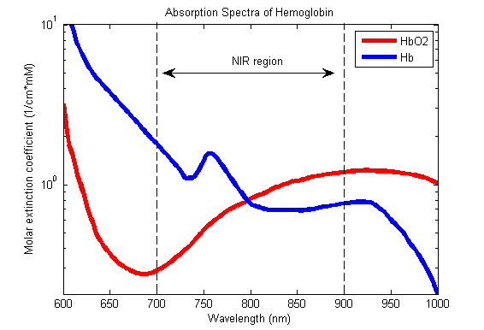
Fundamental Principles
Absorption Spectrum of Oxyhemoglobin (HbO₂) and deoxyhemoglobin (Hb). The difference at Red and Infrared Points, which coincides to the wavelength of 700 nm and 900 nm, respectively, is used by pulse oximeter.

Slide 10
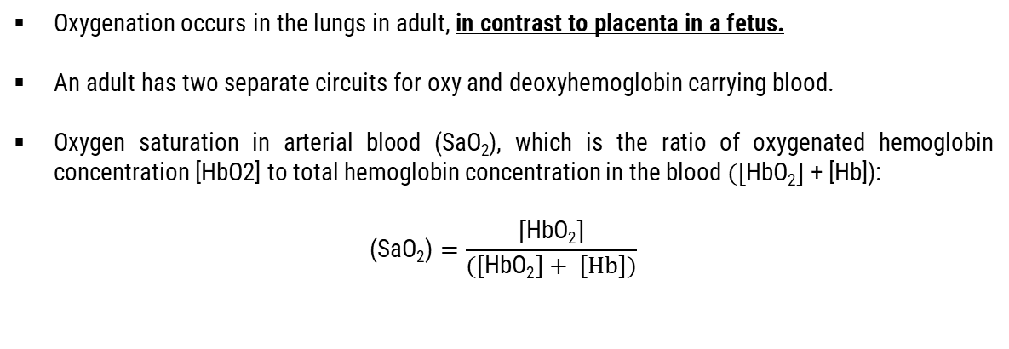
Fundamental Principles
Oxygenation occurs in the lungs in adult, in contrast to placenta in a fetus.
An adult has two separate circuits for oxy and deoxyhemoglobin carrying blood.
Oxygen saturation in arterial blood (SaO₂), which is the ratio of oxygenated hemoglobin concentration [HbO2] to total hemoglobin concentration in the blood $([\text{HbO}\text{2}]$+ [Hb]):
$$\text{(}\text{SaO}\text{2}\text{)}=\frac{[\text{HbO}\text{2}]}{([\text{HbO}\text{2}]+ [Hb])}$$

Slide 11
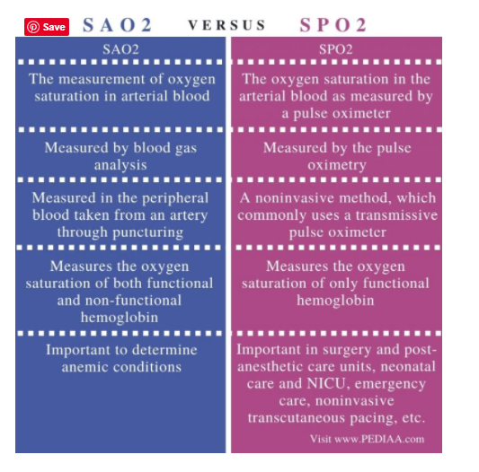
$\text{SaO}\text{2}$ is not commensurable with SpO₂

Slide 12
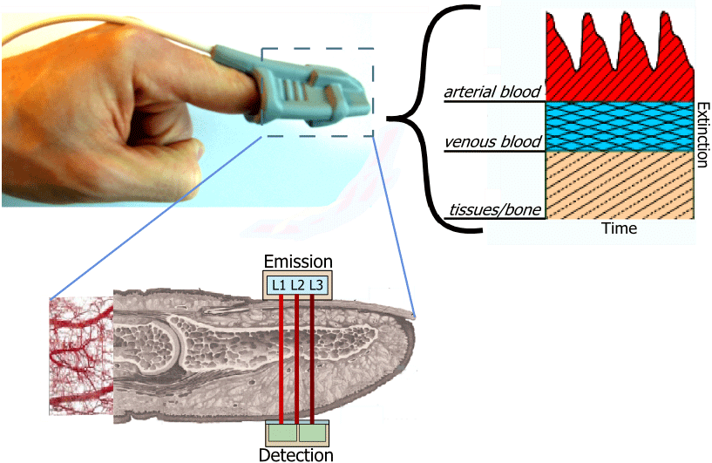


Beer – Lambert Law
C
I₀
I
x
Source
Detector
b

Slide 13
Fetal Circulation mixes the oxygenated and deoxygenated blood
There is a difference between fetal and adult human hemoglobin.
Apart from structure, there is an absorptive difference which is reflected in the absorption spectra of the hemoglobin.
Another hindrance to using SpO₂ (via pulse oximetry) to gauge the oxygenation of fetus is the fact that oxygenated and deoxygenated blood in the fetus mixes.
This is unlike in adult, where there is a separate circuit for flow of oxygenated and deoxygenated blood.

Slide 14
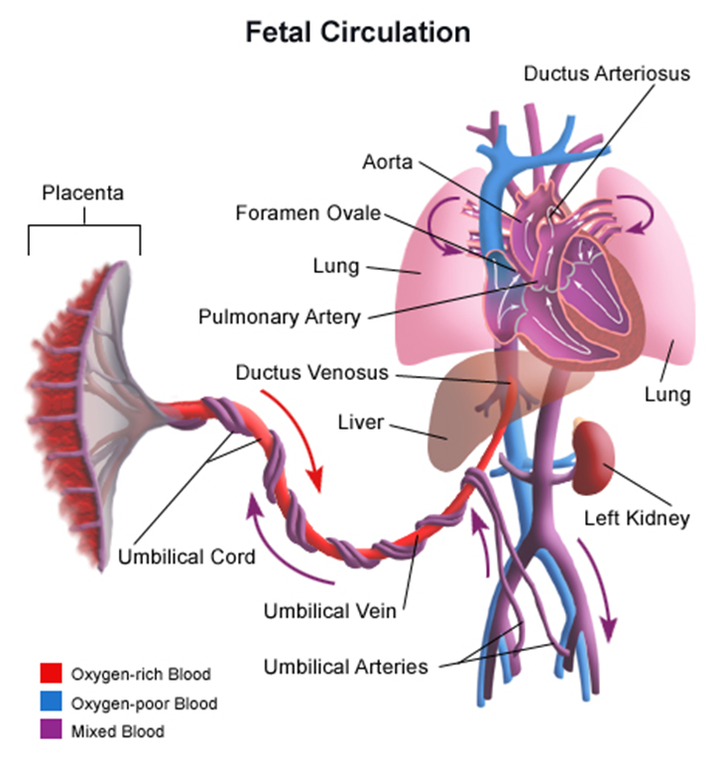
Oxygenated blood is mixed with deoxygenated blood in fetus. Giving rise to incommensurability issues between SpO₂ of fetus and adult.

Slide 15
Two Possible Approaches to solve this problem

Slide 16
Theoretical Modeling and Computational Approach
Most of the theory of classical pulse oximetry is based on approximations on Beer-Lambert law.
As described in the problems section above, there are various constraints to application of this classical model to fetal oximetry. Hence, we will have to refine the model in such a way that it considers, those physiological constraints that the change in the measurement protocol is accounted for.
This can be done by developing mathematical models from first principles. Computational approaches to separate maternal SpO2 signal from Fetal will be developed. Filtering approaches (eg. Kalman Filtering) by combining 2 or more signals will be studied.
An approximation algorithm of Modified Beer Lambert law will be implemented.

Slide 17
Data-Driven Approach
We will have to collaborate with hospitals to acquire data of several parameters before and after birth.
These parameters will be based on literature search. Machine Learning algorithms (e.g. Logistic Regression) and Clustering algorithms can give us probabilities of oxygenation states of fetus.
The parameters of importance will be retained. This way an aggregate score can be made which will increase confidence of measurement of fetal SpO2 and its correlation with fetal oxygen status.

Slide 18
Theoretical Modeling and Computational Approach
5

Slide 19
Research Papers
Design and In Vivo Evaluation of a Non-Invasive
Transabdominal Fetal Pulse Oximeter - 2021
Transabdominal Fetal Pulse Oximetry: The Case of Fetal Signal
Optimization - 2020
Recovering the fetal signal in transabdominal fetal pulse oximetry - 2017
Daniel Fong
Electrical and Computer Engineering
University of California, Davis
IEEE Transactions on Biomedical Engineering – 4.5 IF

Slide 20
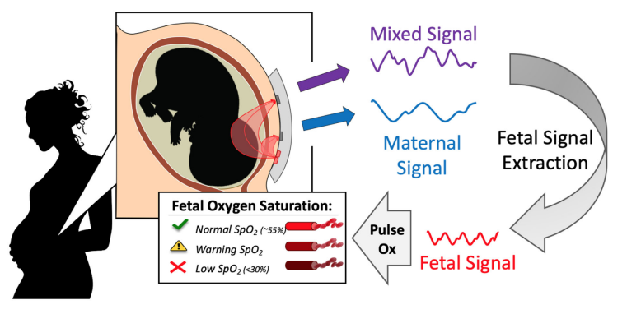
The Process of Fetal SpO2 Extraction
Attach the sensor suitable position of abdomen and gathering the raw data from it and also placed oximeter for mother SpO2 level of mother which attach on finger/Earlobe.
After gather raw data then remove noise and condition the mixed signal (oxygenated Hb & deoxygenated Hb for mother and fetus).
Mixed signal filter out through Beer Lambert's Law that quantized the signal for display in form of graph/number.

Slide 21
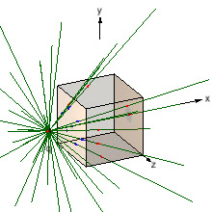
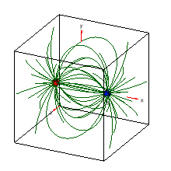
Modifications to law
C
I₀
I
Source
x
Detector
b

Slide 22
SpO2 Data Acquisition System
Emitters-Detectors
Embedded System
Software
UI
Consists of reflectance based optical probe (emitter-detector pair x5) with shielded cable
Amplifiers, ADC, LED driver(s), digital pot, MCU
UI to communicate MCU via virtual COM port

Slide 23
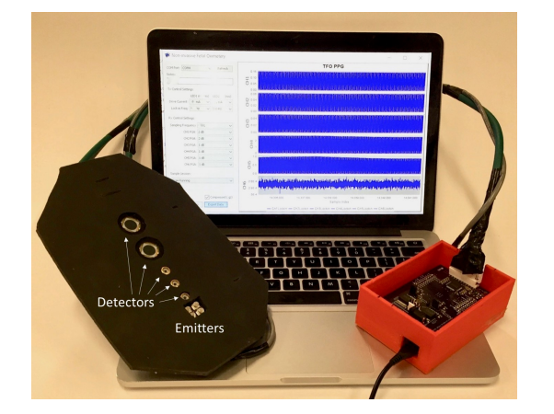
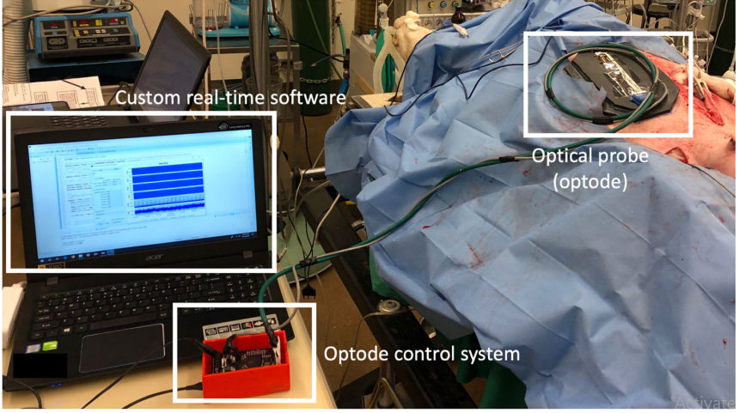

Slide 24
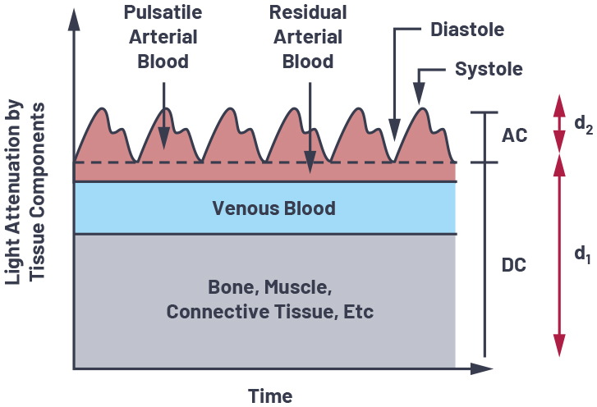
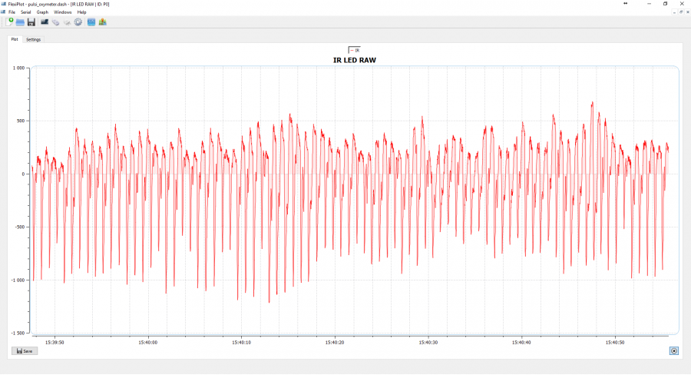
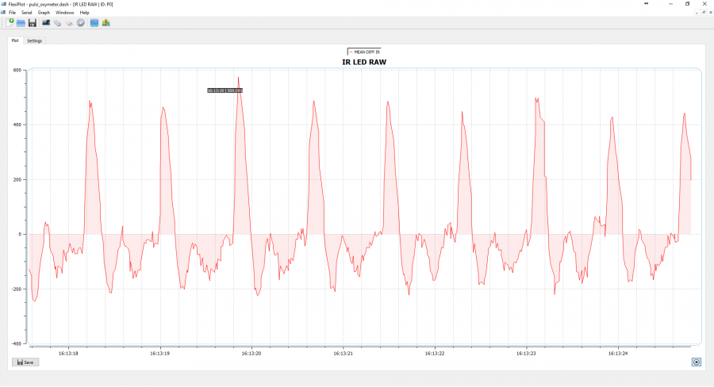
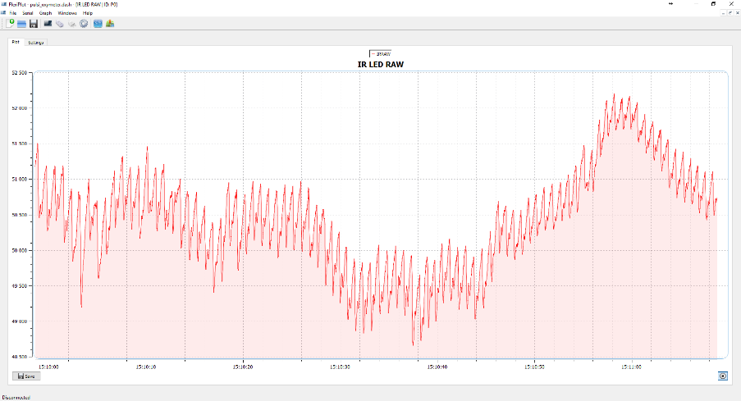
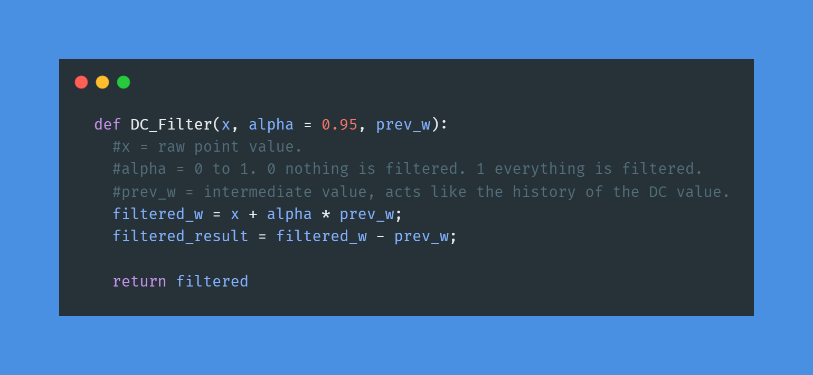
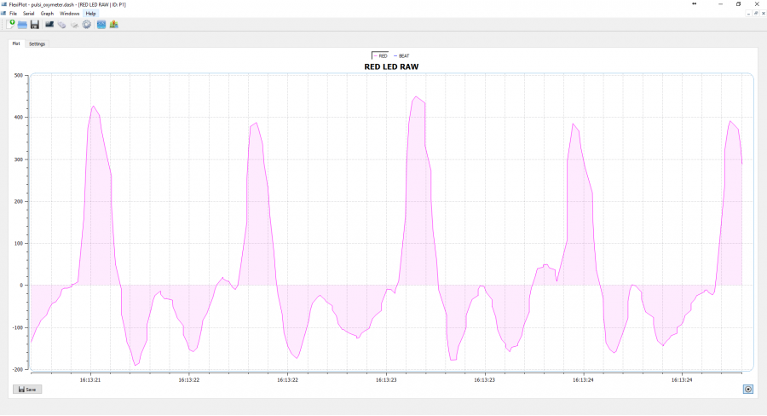
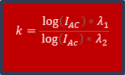

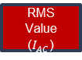
Red
LED (λ1)
Detector
IR LED (λ1)
Detector
DC Removal w(t)=x(t)+ ∝ *w(t-1) y(t)=w(t)-w(t-1)
RMS Value ($I_{AC}$)
Mean- Median Filter
$$k=\frac{\log\left(I_{AC}\right){∗λ}_{1}}{\log\left(I_{Ac}\right){∗λ}_{2}}$$
Butterworth Filter
$$SpO2=110 −25 ∗k$$
Peak Detection

Slide 25
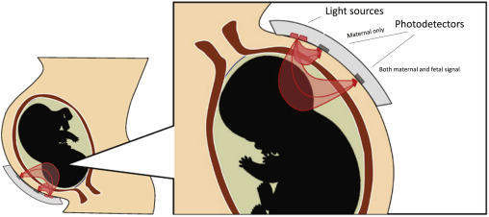


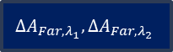

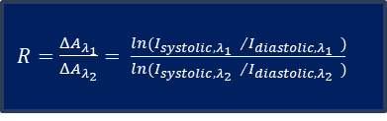


Red
LED (λ1)
Detector
IR LED (λ1)
Detector
Filtering to Enhance Peaks
$$I_{systolic,λ_{1}}$$
$$I_{systolic,λ_{2}}$$
$$I_{diastolic,λ_{1}}$$
$$I_{diastolic,λ_{2}}$$
$ΔA_{{Far,λ}_{1}},ΔA_{{Far,λ}_{2}}$
$R=\frac{ΔA_{λ_{1}}}{ΔA_{λ_{2}}}= \frac{ln({I_{systolic,λ_{1}} }/{I_{diastolic,λ_{1}} )}}{ln({I_{systolic,λ_{2}} }/{I_{diastolic,λ_{2}} )}}$
$ΔA_{{Near,λ}_{1}},ΔA_{{Near,λ}_{2}}$

Slide 26


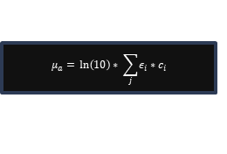



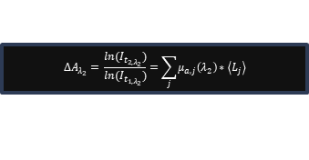
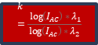


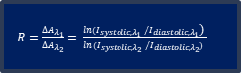
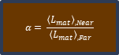



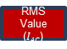



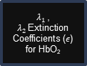
IR LED (λ1)
Detector
DC Removal w(t)=x(t)+ ∝ *w(t-1) y(t)=w(t)-w(t-1)
Mean- Median Filter
Butterworth Filter
Red
LED (λ1)
Detector
$$k=\frac{\log\left(I_{AC}\right){∗λ}_{1}}{\log\left(I_{Ac}\right){∗λ}_{2}}$$
Peak Detection
MCML Simulations
$$SpO2=110 −25 ∗k$$
Filtering to Enhance Peaks
RMS Value ($I_{AC}$)
Mean Path Length $\left\langle L_{mat}\right\rangle$
$$I_{systolic,λ_{1}}$$
$$I_{systolic,λ_{2}}$$
$$I_{diastolic,λ_{1}}$$
$$I_{diastolic,λ_{2}}$$
$$α= \frac{{\left\langle L_{mat}\right\rangle }_{,Near}}{{\left\langle L_{mat}\right\rangle }_{,Far}}$$
$ΔA_{{Far,λ}_{1}},ΔA_{{Far,λ}_{2}}$
$R=\frac{ΔA_{λ_{1}}}{ΔA_{λ_{2}}}= \frac{ln({I_{systolic,λ_{1}} }/{I_{diastolic,λ_{1}}\text{)} }}{ln({I_{systolic,λ_{2}} }/{I_{diastolic,λ_{2}}) }}$
$λ_{1}$, $λ_{2}$Extinction Coefficients ($ε$) for HbO₂
$λ_{1}$, $λ_{2}$Extinction Coefficients ($ε$) for HbO₂
$ΔA_{{Near,λ}_{1}},ΔA_{{Near,λ}_{2}}$
$$ΔA_{λ_{2}}= \frac{ln(I_{t_{2,λ_{2}}})}{ln(I_{t_{1,λ_{2}}})}=\sum_{j}{μ_{a,j}\left(λ_{2}\right)∗\left\langle L_{j}\right\rangle }$$
$$ΔA_{{Fetal,λ}_{1}}=ΔA_{{Far,λ}_{1}}−α∗ΔA_{{Near,λ}_{1}}$$
$$ΔA_{λ_{1}}= \frac{ln(I_{t_{2,λ_{1}}})}{ln(I_{t_{1,λ_{1}}})}=\sum_{j}{μ_{a,j}\left(λ_{1}\right)∗\left\langle L_{j}\right\rangle }$$
$$ΔA_{{Fetal,λ}_{2}}=ΔA_{{Far,λ}_{2}}−α∗ΔA_{{Near,λ}_{2}}$$
Adaptive Filtering (Least Mean Squares)
$$μ_{a}= \ln\left(10\right)∗ \sum_{j}{ε_{i}}∗c_{i}$$
$${SpO}_{2}=\frac{ε_{Hb, λ_{1}}−R∗ε_{Hb, λ_{2}} }{ε_{Hb, λ_{1}}−ε_{Hb{O_{2},λ}_{1}}+R∗(ε_{Hb{O_{2},λ}_{2}}−ε_{Hb, λ_{2}}) }$$

Slide 27
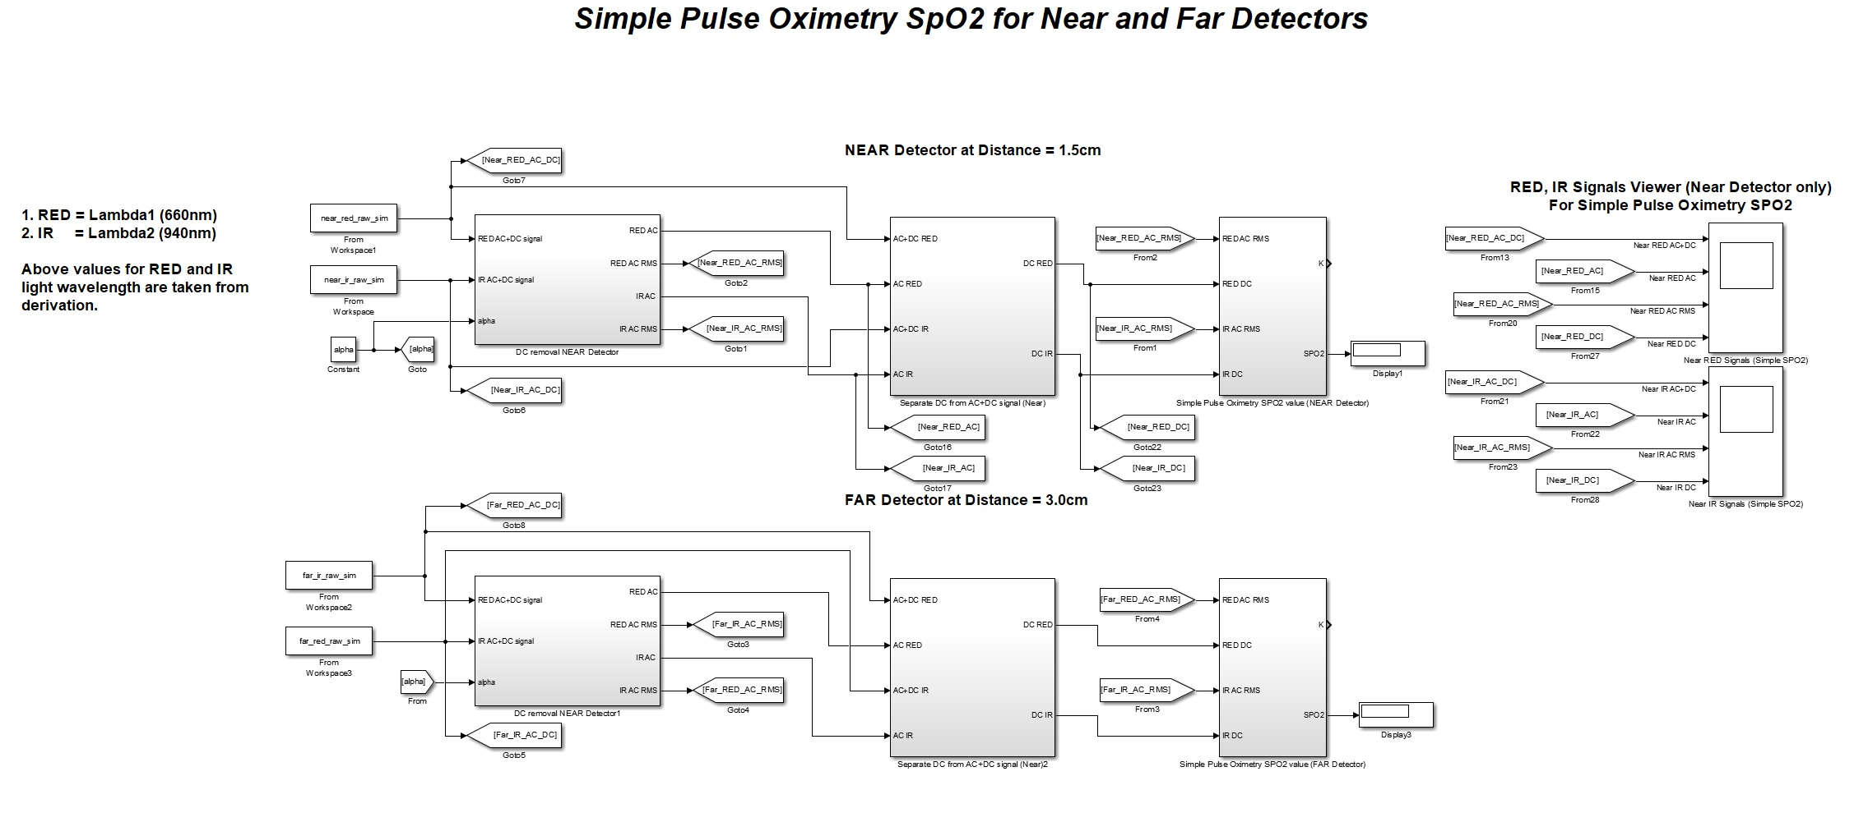
MODEL 1

Slide 28
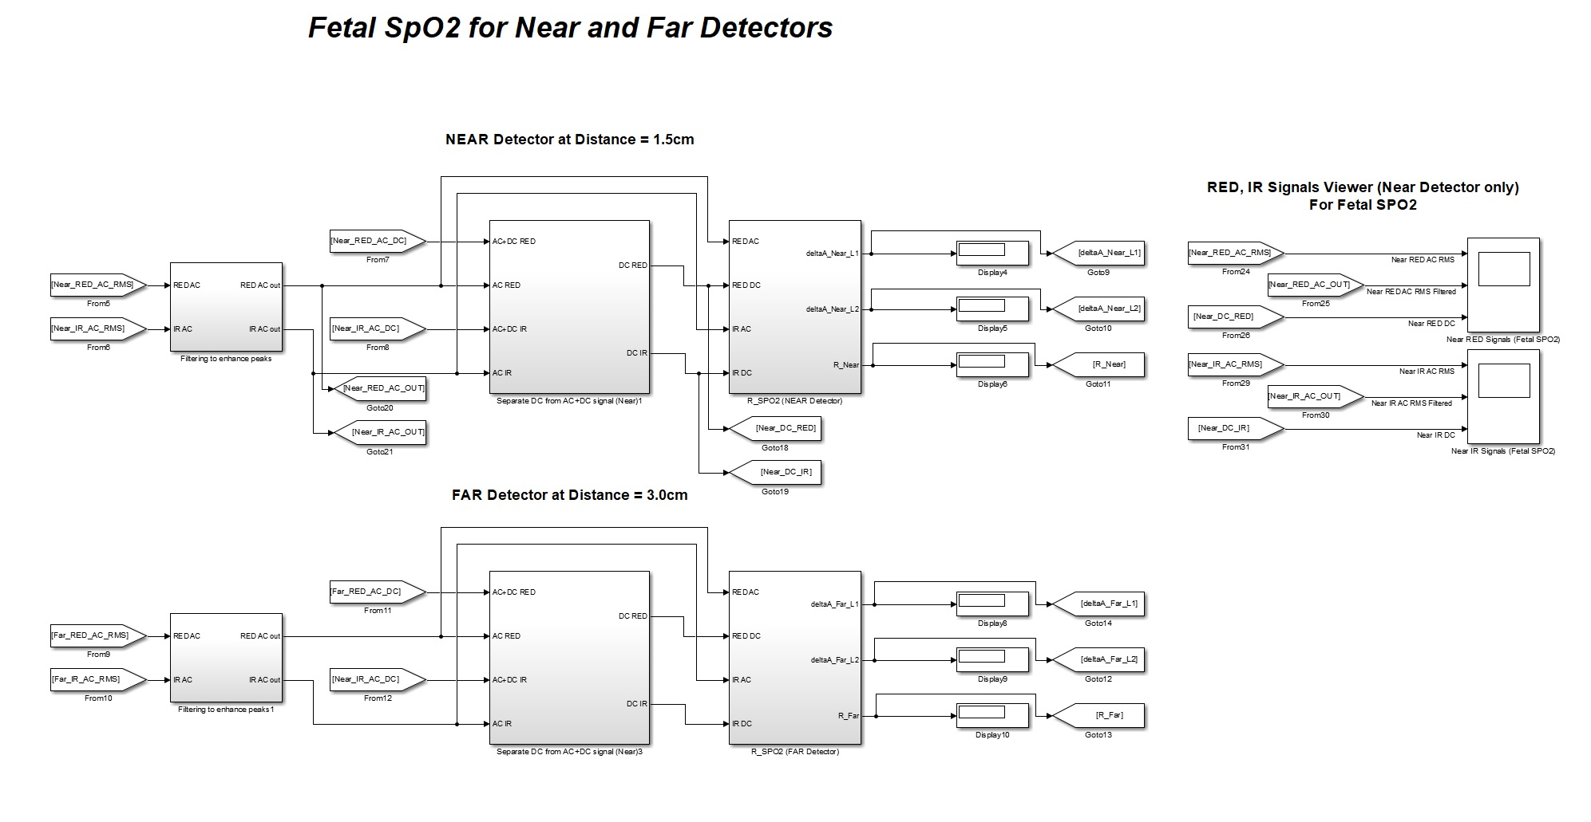
MODEL 2

Slide 29
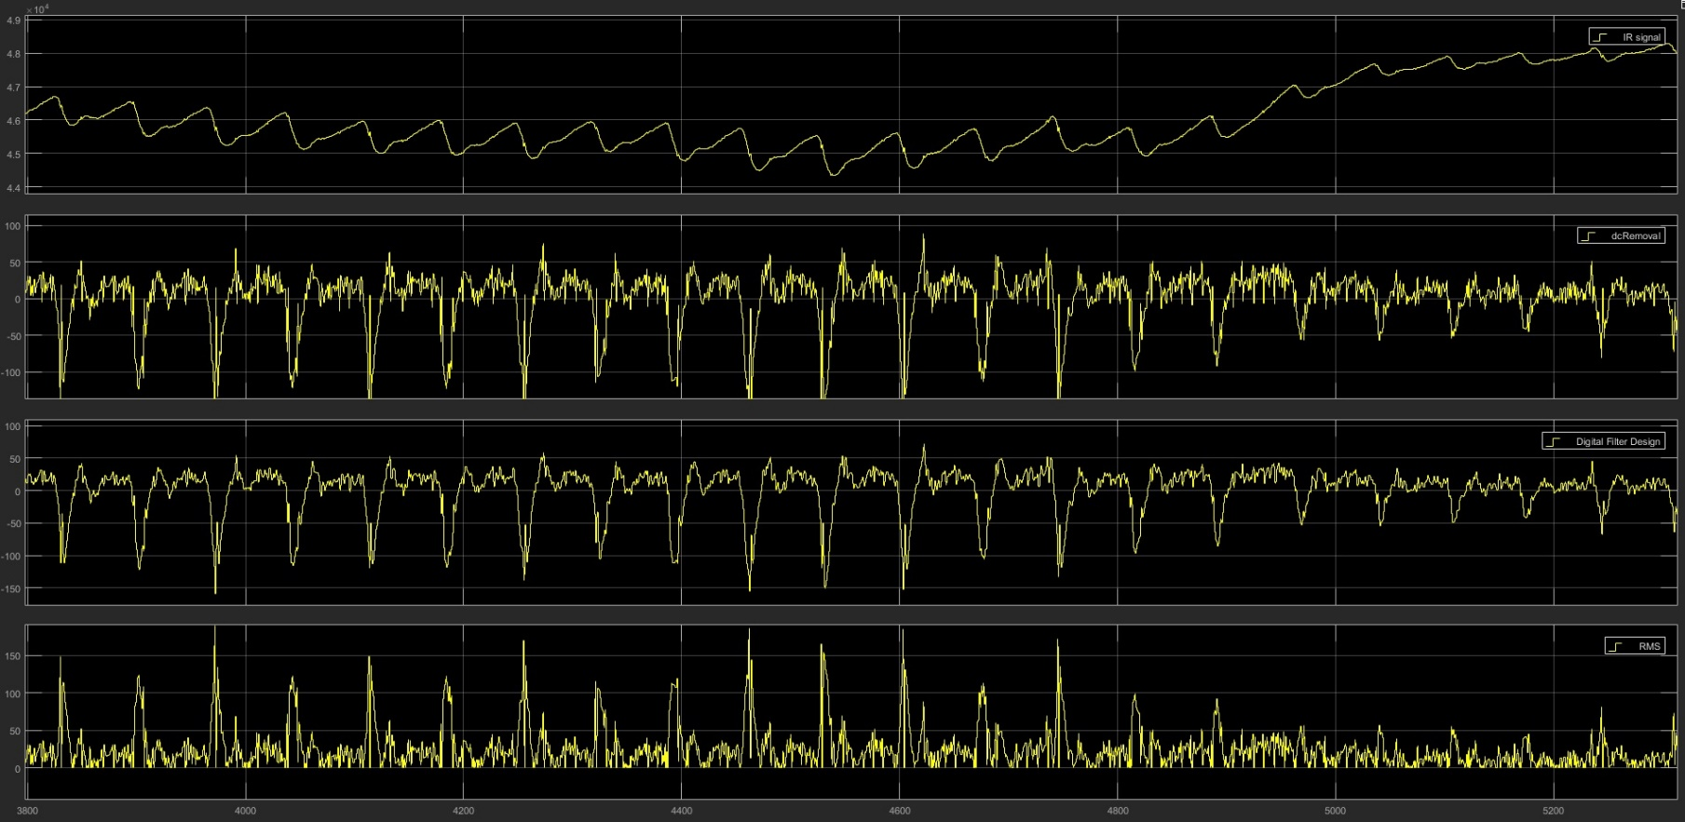
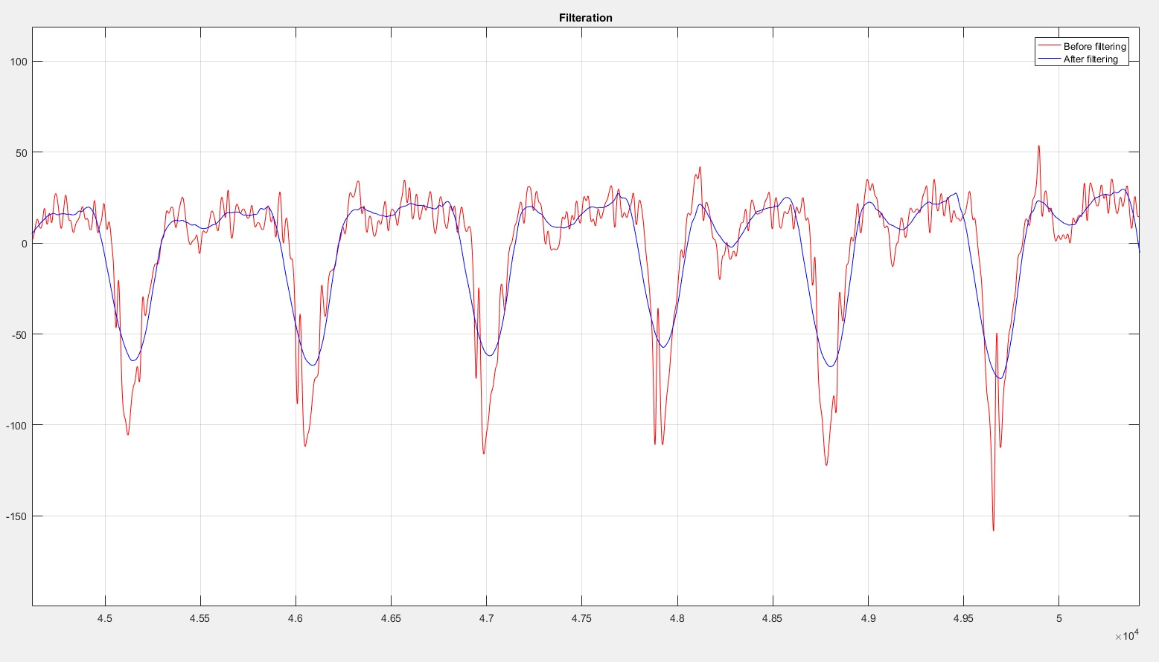
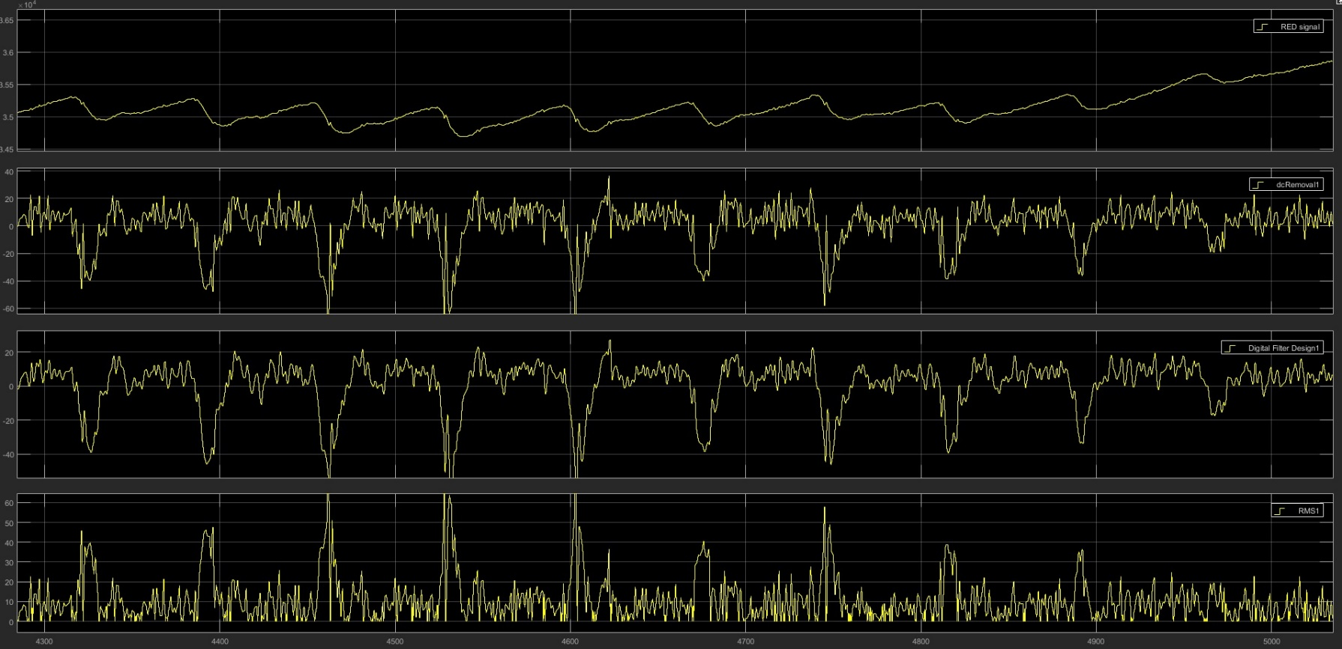
Results
IR OUTPUT
FILTERED DATA
RED OUTPUT

Slide 30
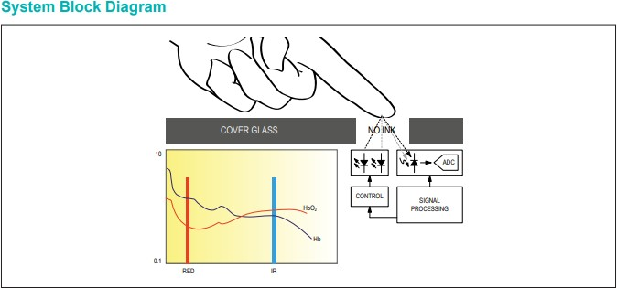
Basic SpO2 Testing
The MAX30100 is an integrated pulse oximetry and heartrate monitor sensor solution. It combines two LEDs, a photodetector, optimized optics, and low-noise analog signal processing to detect pulse oximetry and heart-rate signals.
The MAX30100 operates from 1.8V and 3.3V power supplies and can be powered down through software with negligible standby current, permitting the power supply to remain connected at all times.

Slide 31
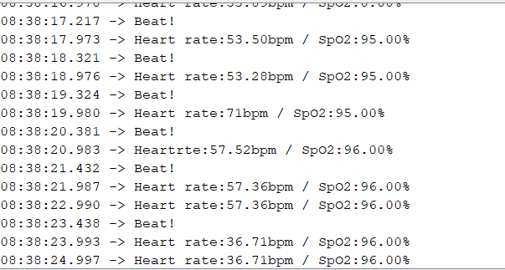
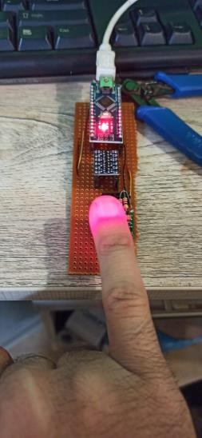
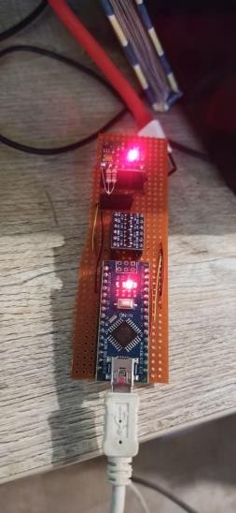
Results:

Slide 32
Emitters-Detectors
Detectors x5
(medium = optical fibre)
Transimpedance Amplifier
Programmable Gain Amp
24-bit ADC
TI ADS131E08
Sampling at 4KHz
Flexible Black Silicone to reduce ambient light
Emitter LEDs
Multidetector optode (detector and emitter)
Emitter (optical fibre)
SMBB740D
740nm RED Wavelength
From LED driver
To Microcontroller
For digital demodulation:
Power Spectral Density Analysis
Adaptive noise cancellation to eliminate flicker noise
Frequency analysis
Emitter (optical fibre)
SMBB850DS
850nm Near-IR Wavelength
From LED driver
740D, 850DS can emit 560mW and 1400mW of radiant power
Digital demodulation = raw ADC data * activation signal of each wavelength

Slide 33
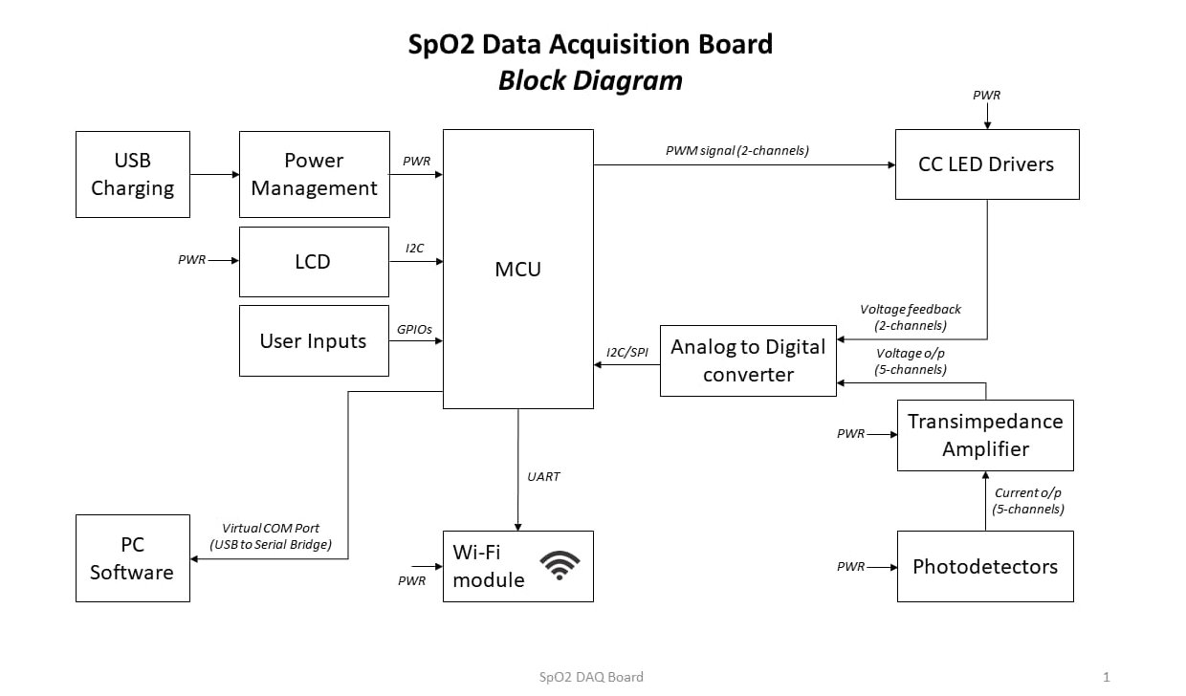
High level system

Slide 34
Data-Driven Approach
6

Slide 35
Data-Driven Approach
Post-Birth Score
1st APGAR Score
5th APGAR Score
10th APGAR
Score SpO2 at Birth
Pre-Birth Variables
CTG Aberrations
Fetal SpO2
Fetal Heart Rate
Cervical Dilatation
Meconium-stained liquor
Parity
Intra Uterine Growth Percentile
Fetal movement

Slide 36
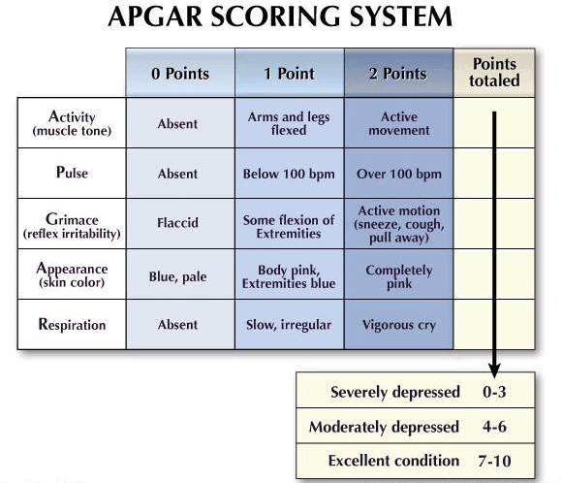
Data-Driven Approach

Slide 37
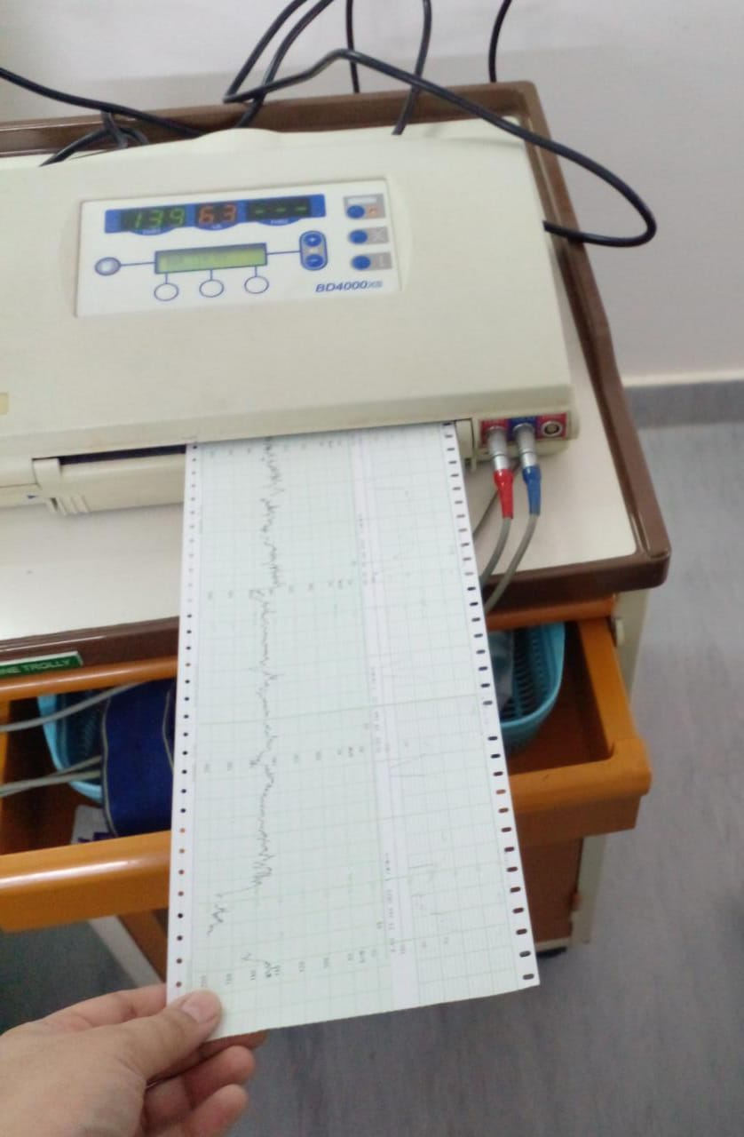
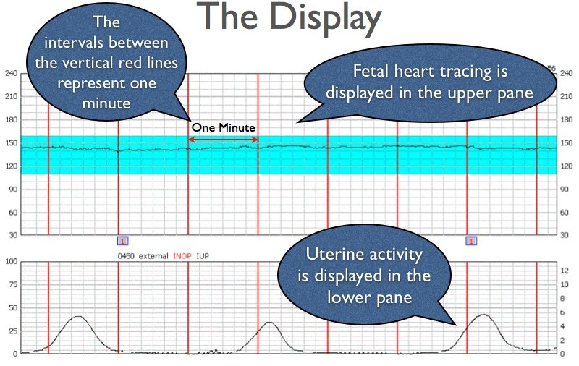
CARDIOTOCOGRAPHY (CTG)

Slide 38
Data-Driven Approach
DATA FORM: Commonly data is in analog form.
MAJOR TRACINGS ON CTG:
Fetal heart rate: 110-160 bpm
Variability: 5-25 bpm.
Stable baseline rate: 120-160bpm
Decelerations: Variable decelerations with no concerning characteristics for less than 90 minutes

Slide 39
Next Milestone
6

Slide 40
Milestones
Developing a Schematic and Bill of Material (BOM) for SpO2 data Acquisition Card.
Getting a Hospital on board for data collection.
Getting Patients pre delivery data and post delivery data for machine learning models
Developing Machine learning models for Data driven approach with the Data.

Slide 41
THANKS!

